Slide 1
Presentation brief for MCT’s
Title of presentation | Support Hybrid Transactional Analytical Processing (HTAP) with Azure Synapse Link
Presentation\Lab length | Presentation: 50 - 60 minutes Lab: 50 – 60 minutes
Audience | Data Engineers, Data Scientists, Data Professionals, Data Architects, BI Professionals, Developers
Purpose | Design hybrid transactional and analytical processing using Azure Synapse Analytics Configure Azure Synapse Link with Azure Cosmos DB Query Azure Cosmos DB with Apache Spark for Azure Synapse Analytics Query Azure Cosmos DB with SQL Serverless for Azure Synapse Analytics
(think) Student key takeaways | The student should understand a hybrid transactional and analytical process within Azure Synapse Analytics The student should be able to configure Azure Synapse Link with Azure Cosmos DB The student should comprehend the query possibilities with Apache Spark Pools and SQL Serverless for Azure Synapse Analytics
(feel) Student desired mindset | The student may feel confusion around a hybrid transactional and analytical process. The student may feel confusion about the difference between querying with Apache Spark Pools versus SQL Serverless Pools in Azure Synapse Analytics The student may feel they are not familiar with different syntax used in the query possibilities
(do) Student outcomes | The student should be able to design a hybrid transactional and analytical process using Azure Synapse Analytics The student should be able to configure Azure Synapse Link with Azure Cosmos DB The students should be able to comprehend the query differences with Apache Spark and SQL Serverless for Azure Synapse Analytics
More information | For MCT course feedback, visit the Microsoft Official Courseware forum
Notes:
Instructor notes and guidance
This slide is for MCT use only, outlining the aims and objectives of this module.

Slide 2
DP-203T00: Support Hybrid Transactional Analytical Processing (HTAP) with Azure Synapse Link
Notes:
Instructor notes and guidance
Introduce to the students that this module explores support for Hybrid Transactional Analytical Processing (HTAP) with Azure Synapse Link. In this module, the student should be able to gain an understanding of the differences between a transactional store and analytical store in Azure Cosmos DB and how to interact with the storage options to run near real-time analytics over operational data. Then the students will go over the design of a hybrid transactional and analytical processing using Azure Synapse Analytics and Azure Synapse Link against an Azure Cosmos DB data store. They will also configure Azure Synapse link with Azure Cosmos DB. Once the configuration is in place, they will learn about querying Azure Cosmos DB with both Apache Spark pools and SQL serverless pools in Azure Synapse Analytics.
In the lab, we take to opportunity to explore how Azure Synapse Link enables seamless connectivity of an Azure Cosmos DB account to a Synapse workspace. The student will understand how to enable and configure Synapse link, then how to query the Azure Cosmos DB analytical store using Apache Spark and SQL Serverless.

Slide 3
Agenda
Lesson 01 – Design hybrid transactional and analytical processing using Azure Synapse Analytics
Lesson 02 – Configure Azure Synapse Link with Azure Cosmos DB
Lesson 03 – Query Azure Cosmos DB with Apache Spark for Azure Synapse Analytics
Lesson 04 – Query Azure Cosmos DB with SQL Serverless for Azure Synapse Analytics
Notes:
Instructor notes and guidance
This space has been left deliberately blank.

Slide 4
Lesson 01: Design hybrid transactional and analytical processing using Azure Synapse Analytics
Notes:
Instructor notes
This space has been left deliberately blank

Slide 5
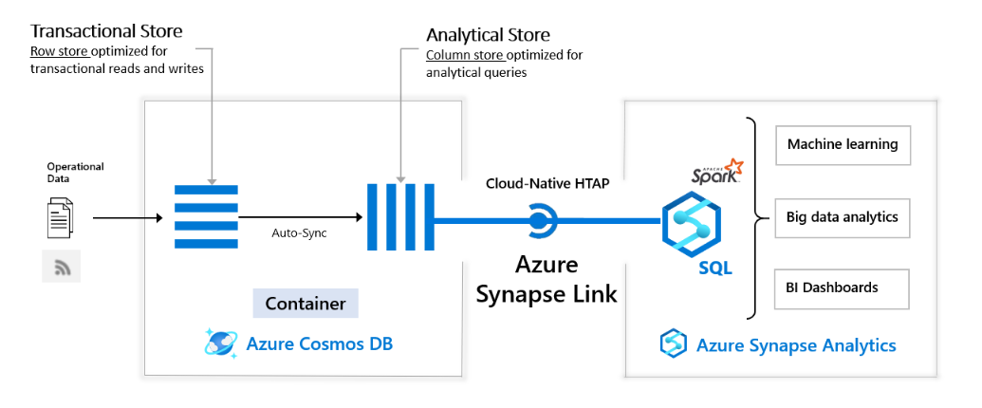
Design hybrid transactional and analytical processing using Azure Synapse Analytics
Notes:
Talking points
Azure Synapse Link for Azure Cosmos DB is a cloud-native hybrid transactional and analytical processing (HTAP) capability that enables you to run near real-time analytics over operational data in Azure Cosmos DB. Azure Synapse Link creates a tight seamless integration between Azure Cosmos DB and Azure Synapse Analytics.
The architecture shown in this slide, depicts how to design a hybrid transactional and analytical process using Azure Synapse Analytics.
On the left-hand side, it shows the operational data, that comes in at the transactional store in a container in Azure Cosmos DB.
An auto-sync takes place to move the operational data to the analytical store, also stored in an Azure Cosmos DB container.
Then, through Cloud-Native HTAP with Azure Synapse Link, the data can be stored in Azure Synapse Analytics where you can use the data for machine learning and analytical services.
Synapse Link brings together Azure Cosmos DB analytical store with Azure Synapse analytics runtime support. This integration enables you to build cloud native HTAP (Hybrid transactional/analytical processing) solutions that generate insights based on real-time updates to your operational data over large datasets. It unlocks new business scenarios to raise alerts based on live trends, build near real-time dashboards, and business experiences based on user behaviour.
Using Azure Cosmos DB analytical store, a fully isolated column store, Azure Synapse Link enables no Extract-Transform-Load (ETL) analytics in Azure Synapse Analytics, against your operational data at scale. Business analysts, data engineers and data scientists can now use Synapse Spark or Synapse SQL interchangeably to run near real-time business intelligence, analytics, and machine learning pipelines. You can achieve this without impacting the performance of your transactional workloads on Azure Cosmos DB.
If you have different roles within you’re organizations, this could be a starting point for use cases per role to develop HTAP with Azure Synapse Analytics, Synapse Link and Azure Cosmos DB:
A data engineer who wants to make data accessible for consumers, by creating SQL or Spark tables over Azure Cosmos DB containers without manual ETL processes.
A BI engineer who wants to model and publish a report to access the operational data in Azure Cosmos DB directly through Synapse SQL.
A data analyst who wants to derive insights from the operational data in an Azure Cosmos DB container by querying it with Synapse SQL, read the data at scale and combine those findings with other data sources.
A data scientist who wants to use Synapse Spark to find a feature to improve their model and train that model without doing complex data engineering. They can also write the results of the model post inference into Azure Cosmos DB for real-time scoring on the data through Spark Synapse.
When looking at processes, Synapse Link is recommended in the following cases:
If you are an Azure Cosmos DB customer and you want to run analytics, BI, and machine learning over your operational data. In such cases, Synapse Link provides a more integrated analytics experience without impacting your transactional store’s provisioned throughput. For example:
If you are running analytics or BI on your Azure Cosmos DB operational data directly using separate connectors today, or
If you are running ETL processes to extract operational data into a separate analytics system.
In such cases, Synapse Link provides a more integrated analytics experience without impacting your transactional store’s provisioned throughput. Synapse Link is not recommended if you are looking for traditional data warehouse requirements such as high concurrency, workload management, and persistence of aggregates across multiple data sources.
For more information, see common scenarios that can be powered with Azure Synapse Link for Azure Cosmos DB.
To analyze large operational datasets while minimizing the impact on the performance of mission-critical transactional workloads, traditionally, the operational data in Azure Cosmos DB is extracted and processed by Extract-Transform-Load (ETL) pipelines. ETL pipelines require many layers of data movement resulting in much operational complexity, and performance impact on your transactional workloads. It also increases the latency to analyze the operational data from the time of origin. When compared to the traditional ETL-based solutions, Azure Synapse Link for Azure Cosmos DB offers several advantages such as:
Reduced complexity with No ETL jobs to manage
Azure Synapse Link allows you to directly access Azure Cosmos DB analytical store using Azure Synapse Analytics without complex data movement. Any updates made to the operational data are visible in the analytical store in near real-time with no ETL or change feed jobs. You can run large scale analytics against analytical store, from Synapse Analytics, without additional data transformation.
Near real-time insights into your operational data
You can now get rich insights on your operational data in near real-time, using Azure Synapse Link. ETL-based systems tend to have higher latency for analyzing your operational data, due to many layers needed to extract, transform and load the operational data. With native integration of Azure Cosmos DB analytical store with Azure Synapse Analytics, you can analyze operational data in near real-time enabling new business scenarios.
No impact on operational workloads
With Azure Synapse Link, you can run analytical queries against an Azure Cosmos DB analytical store (a separate column store) while the transactional operations are processed using provisioned throughput for the transactional workload (a row-based transactional store). The analytical workload is served independent of the transactional workload traffic without consuming any of the throughput provisioned for your operational data.
Optimized for large-scale analytics workloads
Azure Cosmos DB analytical store is optimized to provide scalability, elasticity, and performance for analytical workloads without any dependency on the compute run-times. The storage technology is self-managed to optimize your analytics workloads. With built-in support into Azure Synapse Analytics, accessing this storage layer provides simplicity and high performance.
Cost effective
With Azure Synapse Link, you can get a cost-optimized, fully managed solution for operational analytics. It eliminates the extra layers of storage and compute required in traditional ETL pipelines for analyzing operational data. Azure Cosmos DB analytical store follows a consumption-based pricing model, which is based on data storage and analytical read/write operations and queries executed . It doesn’t require you to provision any throughput, as you do today for the transactional workloads. Accessing your data with highly elastic compute engines from Azure Synapse Analytics makes the overall cost of running storage and compute very efficient.
Analytics for locally available, globally distributed, multi master data
You can run analytical queries effectively against the nearest regional copy of the data in Azure Cosmos DB. Azure Cosmos DB provides the state-of-the-art capability to run the globally distributed analytical workloads along with transactional workloads in an active-active manner.
Instructor notes and guidance
Its important to make the distinction between the transactional and analytical store within Azure Cosmos DB and how Azure Synapse link relates to that.
Explain the concept of transactional store, as a row store optimized for transactional reads and writes, whereas an analytical store is a column store optimized for analytical queries.
The integration through Azure Synapse link, based on cloud-native HTAP, enables analytical workload in Azure Synapse Analytics. Finally tell the students that whilst the example here is based on Azure Cosmos DB as the transactional source, Microsoft are looking into increasing the scope of the transactional store with additional technologies such as SQL Database and Postgres DB in the future.
Recommended reading for this slide
Design hybrid transactional and analytical processing using Azure Synapse Analytics - Learn | Microsoft Docs

Slide 6
Lesson 02: Configure Azure Synapse Link with Azure Cosmos DB
Notes:
Instructor notes
This space has been left deliberately blank

Slide 7
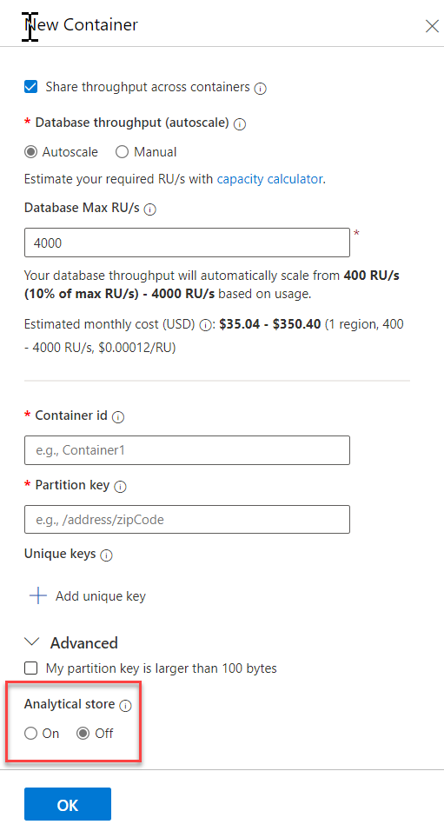
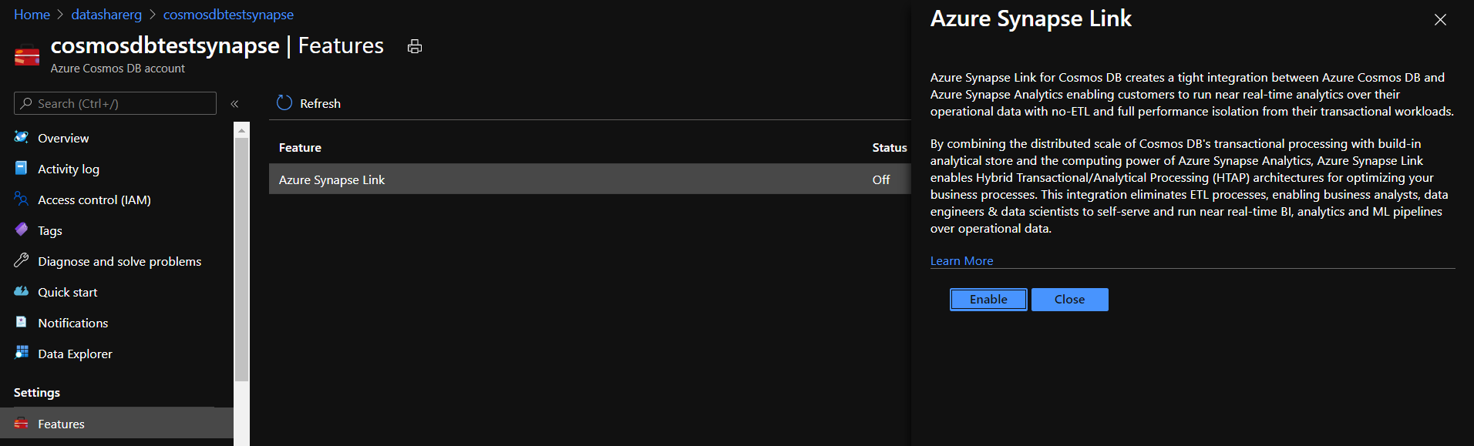
Configure Azure Synapse Link with Azure Cosmos DB
Notes:
Talking points
Synapse Link for Azure Cosmos DB is a cloud-native hybrid transactional and analytical processing (HTAP) capability that enables you to run near real-time analytics over operational data in Azure Cosmos DB. Synapse Link creates a tight seamless integration between Azure Cosmos DB and Azure Synapse Analytics.
It is important to keep in mind that, to use Azure Synapse Link, ensure you provision your Azure Cosmos account & Azure Synapse Analytics workspace in one of the supported regions. Azure Synapse Link is currently available in the following Azure regions: US West Central, East US, West US2, North Europe, West Europe, South Central US, Southeast Asia, Australia East, East U2, UK South.
When deploying the account in one of the supported regions, your Cosmos DB account should be enabled to use Synapse Link. To understand how to create an analytical store enabled container to automatically start replicating your operational data from the transactional store to the analytical store, you can follow the following steps:
Create an Azure cosmos Container with Analytical Store:
You can turn on analytical store on an Azure Cosmos container while creating the container. You can use the Azure portal or configure the analytical Time To Live (TTL) property during container creation by using the Azure Cosmos DB SDKs.
Select New Container and enter a name for your database, container, partition key and throughput details. Turn on the Analytical store option. After you enable the analytical store, it creates a container with Analytical TTL property set to the default value of -1 (infinite retention). This is the analytical store that retains all the historical versions of records.
If you have previously not enabled Synapse Link on an account, it will prompt you to do so because it's a pre-requisite to create an analytical store enabled container. If prompted, select Enable Synapse Link. Then select OK, to create an analytical store enabled Azure Cosmos container.
The definition of an HTAP container is a container with Synapse Link enabled. This container has both transactional store and analytical store.
In order to connect Cosmos DB to your Azure Synapse Analytics workspace, you should navigate to the Synapse studio environment and navigate to the data tab, such that you can connect to external data. If you do so, you have the option to connect to the Azure Cosmos DB account/container such that you can query data stored there in a notebook where you can use Spark or for example SQL commands.
Instructor notes and guidance
This is a build slide. The first click will remove the image that shows you how to enable Azure Synapse Link in Azure Cosmos DB. Click 2 should how you can enable the analytical store in a new container screen once the feature has been enabled
The student will run through all the steps of how to set up the Azure Synapse Link feature for Cosmos DB, in the lab. However, it’s imperative they understand that within Cosmos DB they need to adjust the setting in order to use Synapse Link.
Recommended reading for this slide
https://docs.microsoft.com/en-us/learn/modules/configure-azure-synapse-link-with-azure-cosmos-db/2-enable-cosmos-db-account-to-use
https://docs.microsoft.com/en-us/learn/modules/configure-azure-synapse-link-with-azure-cosmos-db/3-create-analytical-store-enabled-container

Slide 8
Lesson 03: Query Azure Cosmos DB with Apache Spark for Azure Synapse Analytics
Notes:
Instructor notes
This space has been left deliberately blank

Slide 9
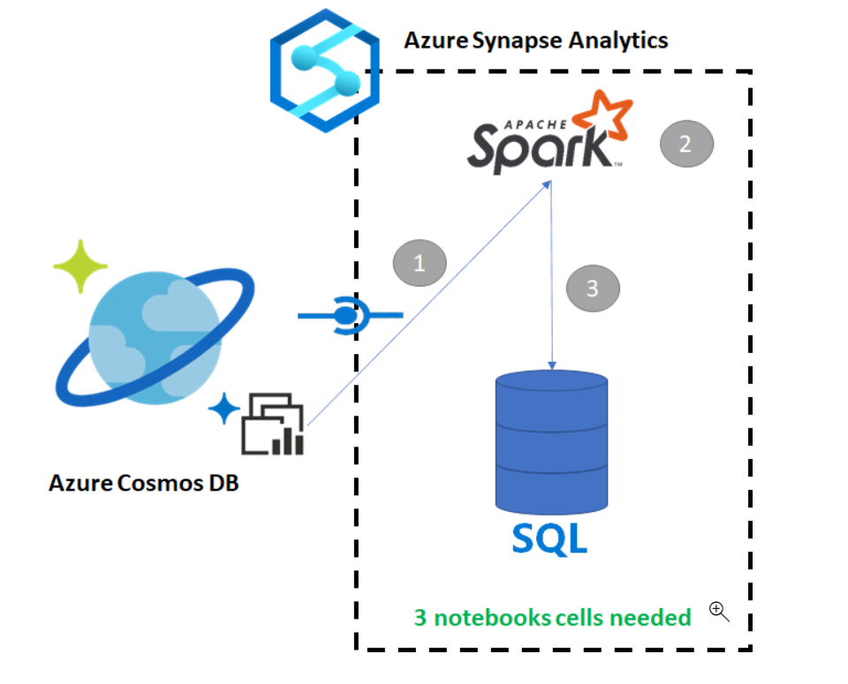
Query Azure Cosmos DB with Apache Spark for Azure Synapse Analytics
Step 1: Load the data in Spark
Step 2: Create a base DataFrame
Step 3: Flatten JSON data
Step 4: Create the final DataFrame
Notes:
Talking Points:
Azure Synapse Link for Azure Cosmos DB enables users to run near real-time analytics over operational data in Azure Cosmos DB. However, there are times when some data needs to be aggregated and enriched to serve data warehouse users. Curating and exporting Synapse Link data can be done with just a few cells in a notebook.
Certain steps that involve querying Azure Cosmos DB with SQL serverless for Azure Synapse Analytics are depicted in the slide and explained below:
Steps
When you connect to the analytical store there is no impact on the transactional store (it will not consume any Request Units).
Read the Cosmos DB HTAP container into a Spark DataFrame
Aggregate the results in a new DataFrame
Ingest the data into a SQL pool
The steps that are involved copying data from an Azure Cosmos DB into a SQL Pool while using Apache Spark or a SQL script enabled in Synapse analytics are as follows:
1. Load the data in Spark
2. Create a base DataFrame
3. Flatten JSON data
4. Create the final DataFrame
Instructor notes and guidance
Students will copy data from an Azure Cosmos DB into a SQL pool using Apache spark during the lab and perform the steps as mentioned in the talking points.
Recommended reading for this slide
Query Azure Cosmos DB with SQL Serverless for Azure Synapse Analytics - Learn | Microsoft Docs

Slide 10
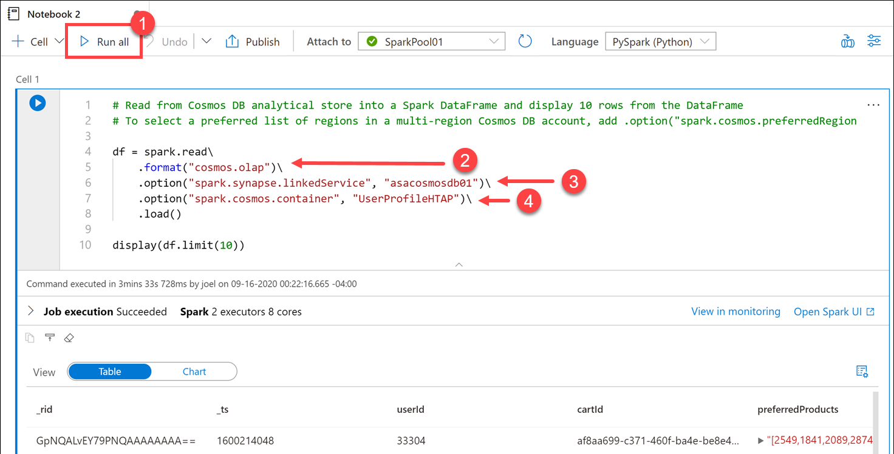

Query Azure Cosmos DB with Apache Spark for Azure Synapse Analytics (continued #1)
Step 1:
Load data to DataFrame
Notes:
Talking points
The steps that involve to querying a Cosmos DB container with Apache Spark in Synapse Analytics are as follows:
Step1 : Load data to DataFrame
In this step, you'll read data from Azure Cosmos DB analytical store in a Spark DataFrame.
Once your data is loaded into a DataFrame, you can perform additional analysis.
This operation doesn't impact the transactional store.
Instructor notes and guidance
In the generated code within Cell 1, notice that the spark.read format is set to cosmos.olap (2). This instructs Synapse Link to use the container's analytical store. If we wanted to connect to the transactional store instead, like to read from the change feed or write to the container, we'd use cosmos.oltp instead. Note: You cannot write to the analytical store, only read from it. If you want to load data into the container, you need to connect to the transactional store. The first option configures the name of the Azure Cosmos DB linked service (3). The second option defines the Azure Cosmos DB container from which we want to read (4).
Recommended reading for this slide
https://docs.microsoft.com/en-us/learn/modules/query-azure-cosmos-db-with-apache-spark-for-azure-synapse-analytics/

Slide 11
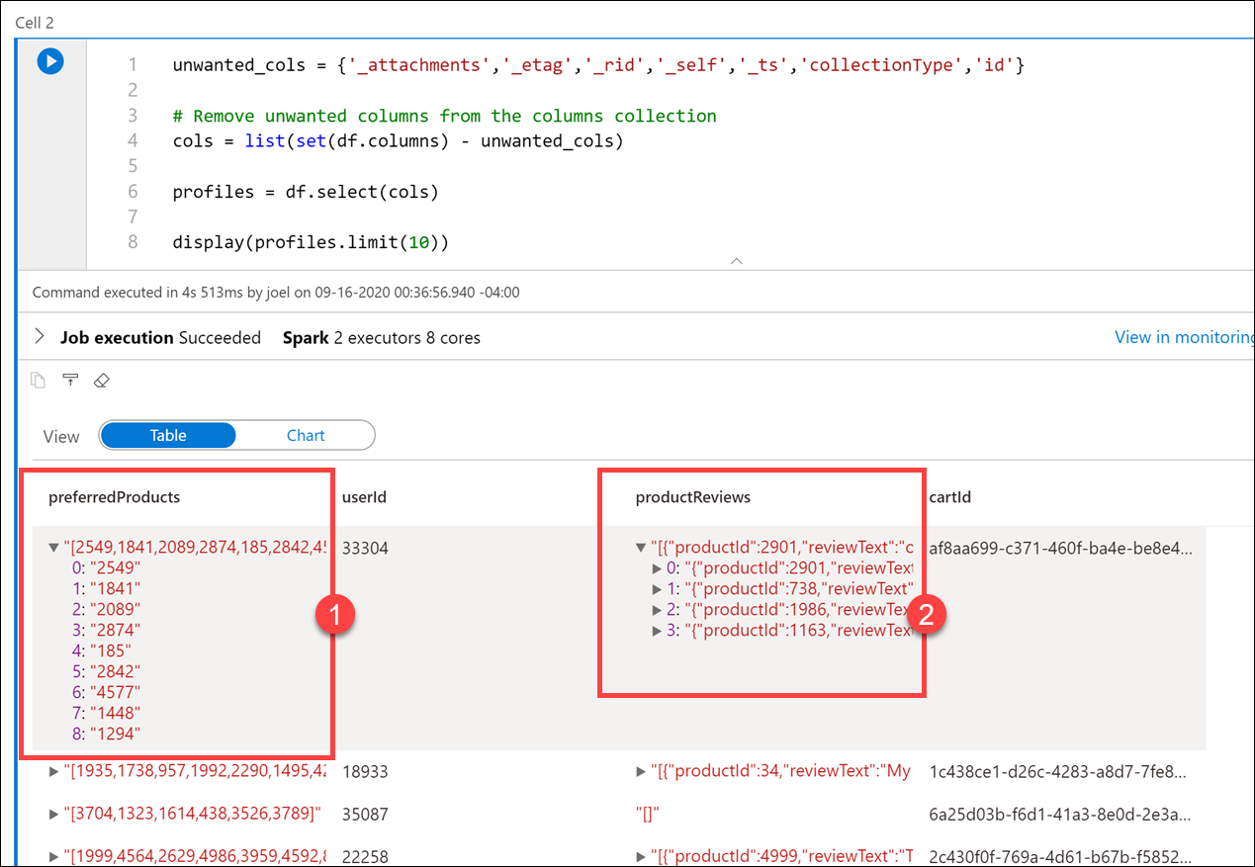
Query Azure Cosmos DB with Apache Spark for Azure Synapse Analytics (continued #2)
Step 2:
Create a base DataFrame
Notes:
Talking points
Step 2: Create a base DataFrame
Here you'll create a base DataFrame pointing to the container you selected.
Instructor notes and guidance
The DataFrame contains extra columns that we don't need. Let's remove the unwanted columns and create a clean version of the DataFrame. To do this, enter the following in the new cell and run it:
unwanted_cols = {'_attachments','_etag','_rid','_self','_ts','collectionType','id'}
# Remove unwanted columns from the columns collection
cols = list(set(df.columns) - unwanted_cols)
profiles = df.select(cols)
display(profiles.limit(10))
The output now only contains the columns that we want. Notice that the preferredProducts (1) and productReviews 2 columns contain child elements. Expand the values on a row to view them. You may recall seeing the raw JSON format in the UserProfiles01 container within the Azure Cosmos DB Data Explorer.
Recommended reading for this slide
https://docs.microsoft.com/en-us/learn/modules/query-azure-cosmos-db-with-apache-spark-for-azure-synapse-analytics/

Slide 12
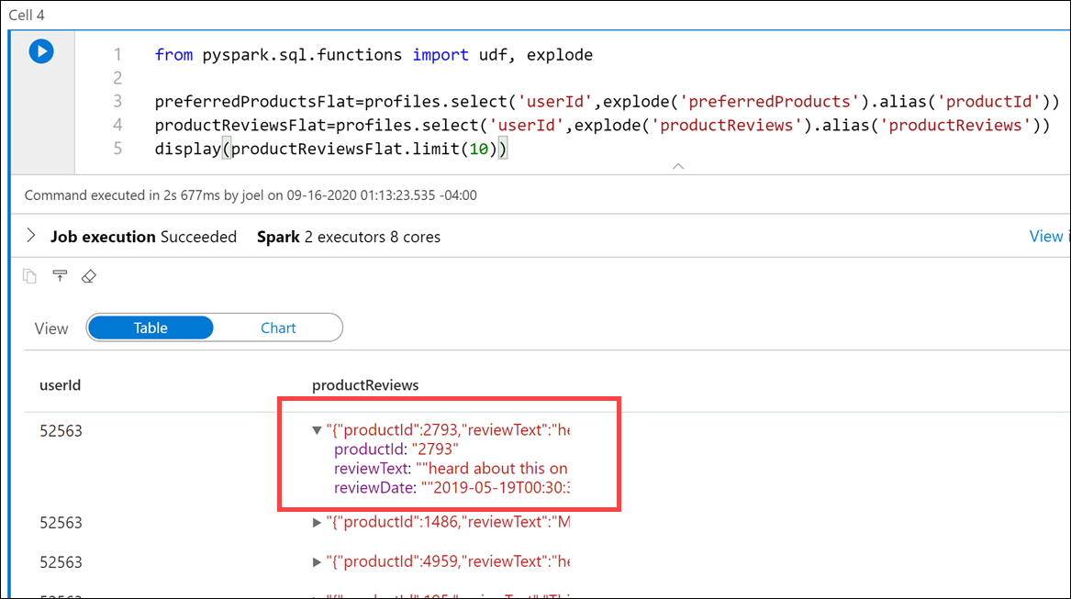
Query Azure Cosmos DB with Apache Spark for Azure Synapse Analytics (continued #3)
Step 3:
Flattening JSON data
Notes:
Talking points
Step 3: Flattening JSON data
We want to use the preferredProducts column array and productReviews column array for each user and create a graph of products that are from their preferred list that match with products that they have reviewed. To do this, we need to create two new DataFrames that contain flattened values from those two columns so we can join them in a later step.
Instructor notes and guidance
In this cell, we imported the special PySpark explode function, which returns a new row for each element of the array. This function helps flatten the preferredProducts and productReviews columns for better readability or for easier querying. You can flatten dataset as many times as you need to structure the data the way you want it
Recommended reading for this slide
https://docs.microsoft.com/en-us/learn/modules/query-azure-cosmos-db-with-apache-spark-for-azure-synapse-analytics/

Slide 13
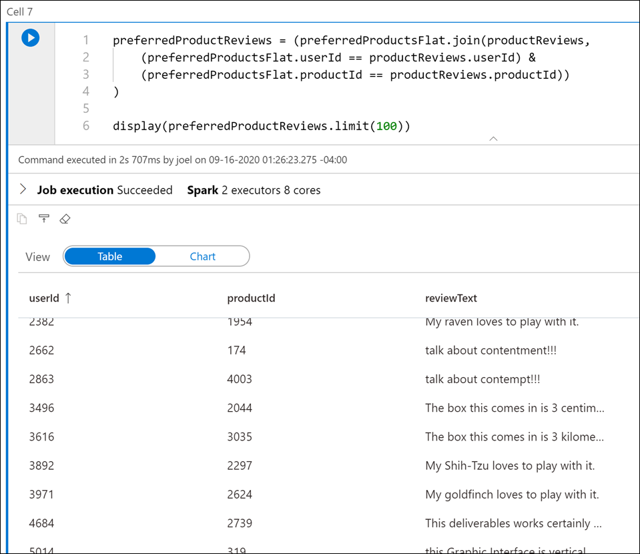
Query Azure Cosmos DB with Apache Spark for Azure Synapse Analytics (continued #4)
Step 4:
Creating the final DataFrame
Notes:
Talking points
Step 4: Creating the final DataFrame
The final step is to join the preferredProductsFlat and productReviews DataFrames on the userId and productId values to build our graph of preferred product reviews. To do this, enter the following in a new cell and run it:
preferredProductReviews = (preferredProductsFlat.join(productReviews,
(preferredProductsFlat.userId == productReviews.userId) &
(preferredProductsFlat.productId == productReviews.productId))
)
display(preferredProductReviews.limit(100))
Instructor notes and guidance
Inform the students that they will work through an expanded version of this example in the lab
Recommended reading for this slide
https://docs.microsoft.com/en-us/learn/modules/query-azure-cosmos-db-with-apache-spark-for-azure-synapse-analytics/

Slide 14
Lesson 04: Query Azure Cosmos DB with SQL Serverless for Azure Synapse Analytics
Notes:
Instructor notes
This space has been left deliberately blank

Slide 15
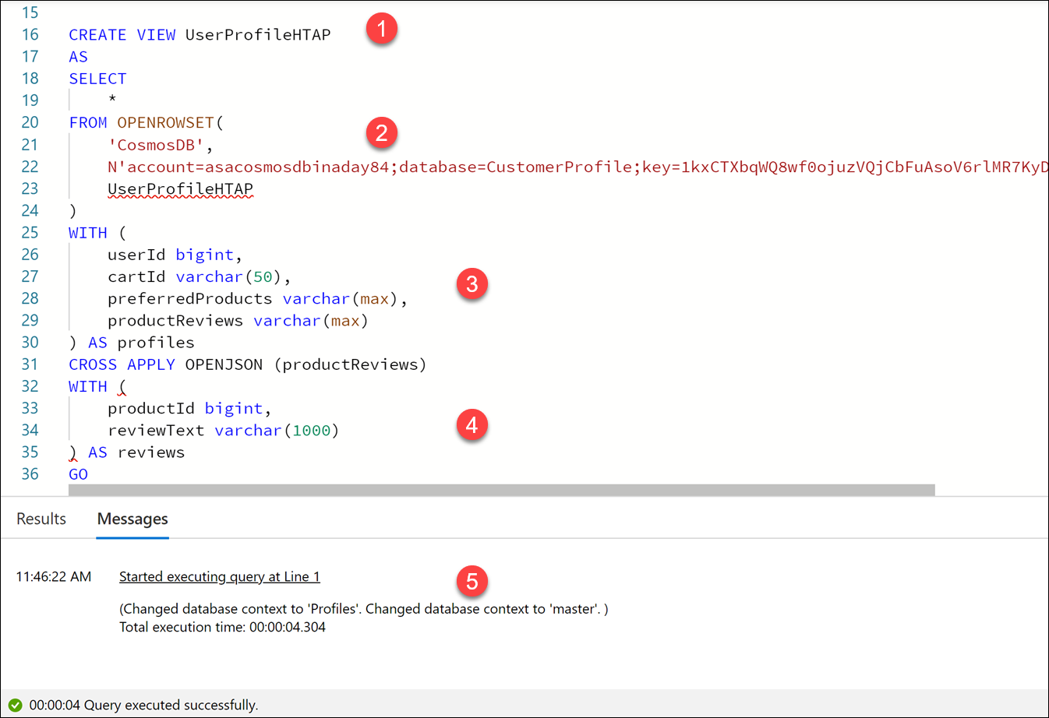
Query Azure Cosmos DB with SQL Serverless for Azure Synapse Analytics
Step 1:
Create a View
Notes:
Talking points
The query starts out by creating a new serverless SQL pool database named Profiles if it does not exist, then executes USE Profiles to run the rest of the script contents against the Profiles database. Next, it drops the UserProfileHTAP view if it exists. Finally, it performs the following:
Creates a SQL view named UserProfileHTAP.
Uses the OPENROWSET statement to set the data source type to CosmosDB, sets the account details, and specifies that we want to create the view over the Azure Cosmos DB analytical store container named UserProfileHTAP.
The WITH clause matches the property names in the JSON documents and applies the appropriate SQL data types. Notice that we set the preferredProducts and productReviews fields to varchar(max). This is because both of these properties contain JSON-formatted data within.
Since the productReviews property in the JSON documents contain nested subarrays, we want to "join" the properties from the document with all elements of the array. Synapse SQL enables us to flatten the nested structure by applying the OPENJSON function on the nested array. We flatten the values within productReviews like we did using the Python explode function earlier in the Synapse Notebook.
The output shows that the statements successfully executed.
Instructor notes and guidance
Inform the students that this is just one example, and that they can create queries that perform cross container queries, query JSON data, and use aggregation or windowing functions within the queries
Recommended reading for this slide
https://docs.microsoft.com/en-us/learn/modules/query-azure-cosmos-db-with-sql-serverless-for-azure-synapse-analytics/

Slide 16
Review questions
Q01 – Where do you enable Azure Synapse Link for Azure Cosmos DB?
A01 – In Azure Cosmos DB
Q02 – How can you manage the lifecycle of data and define how long it will be retained for in an analytical store?
A02 – Configure the default Time to Live (TTL) property for records stored.
Q03 – What is the name of the application architecture that enables near real-time querying to provide insights?
A03 – HTAP
Notes:
Instructor notes and guidance
This space has been left deliberately blank

Slide 17
Lab: Support Hybrid Transactional Analytical Processing (HTAP) with Azure Synapse Link
Notes:
Instructor notes and guidance
This space has been left deliberately blank

Slide 18
Lab overview
This lab teaches you how Azure Synapse Link enables seamless connectivity of an Azure Cosmos DB account to an Azure Synapse workspace. You will understand how to enable and configure Synapse link, then how to query the Azure Cosmos DB analytical store using Apache Spark and SQL Serverless.
Lab objectives
After completing this lab, you will be able to:
Configure Azure Synapse Link with Azure Cosmos DB
Query Azure Cosmos DB with Apache Spark for Synapse Analytics
Query Azure Cosmos DB with serverless SQL pool for Azure Synapse Analytics
Notes:
Instructor notes and guidance
In the lab, we take the opportunity to explore how Azure Synapse Link enables seamless connectivity of an Azure Cosmos DB account to an Azure Synapse workspace. The student will understand how to enable and configure Synapse link, then how to query the Azure Cosmos DB analytical store using Apache Spark and SQL Serverless.
To that end, the lab in this module will be used to configure Azure Synapse Link with Azure Cosmos DB, Query Azure Cosmos DB with Apache Spark for Synapse Analytics, and Query Azure Cosmos DB with serverless SQL pool for Azure Synapse Analytics.
In exercise 1, students will create the linked service and the dataset in order to consume from a container in Azure Cosmos DB.
In exercise 2, they will configure the Azure Synapse Link with Azure Cosmos DB by enabling Azure Synapse link, creating a new Azure Cosmos DB container and creating and running a copy pipeline.
In exercise 3, they will create a notebook in order to query Azure Cosmos DB with Apache spark for Azure Synapse Analytics.
In exercise 4, the query will be replaced by creating a new SQL script in the notebook, in order to query Azure Cosmos DB with a serverless SQL pool for Azure Synapse Analytics.

Slide 19











Lab 12 Overview
asacosmosdb<unique_suffix>
CosmosDB
Customer Profile
Azure Databricks
asagadatalake<unique_suffix>
Cluster
Azure Data Lake
wwi-02
Profiles (json)
dp203sql<unique_suffix>
SourceDB
Synapse Analytics
Dedicated SQL Pool (SQLPool1)
Built-In Serverless SQL Pool
Apache Spark pool
Pipelines and Dataflows
Power BI
asagaworkspace<unique_suffix>
Notes:
This slide is an optional slide that you can use to show a high-level overview of the technologies used in the lab.
This lab teaches you how Azure Synapse Link enables seamless connectivity of an Azure Cosmos DB account to a Synapse workspace. You will understand how to enable and configure Synapse link, then how to query the Azure Cosmos DB analytical store using Apache Spark and SQL Serverless.

Slide 20
Lab review
Q01 – What SparkSQL method reads data from the analytical store?
Q02 – What function provides a rowset view over a JSON document?
Q03 – Which PySpark function helps flatten columns for better readability and ease of querying?
Notes:
Answers
Question 1 - cosmos.olap.
Question 2 – OPENJSON
Question 3 - The explode function

Slide 21
Module summary
In this module, you have learned about:
HTAP
SQL Serverless
Flattening JSON Files
Azure Synapse Link
Azure Cosmos DB
Next steps
After the course, consider visiting the website that explores a [HTAP with Cosmos DB and Synapse Link] pattern and the associated documentation that goes into more depth about this architecture.
Notes:
Instructor notes and guidance
The next steps is suggested post course learning materials to reinforce what they have learned in the module.

Slide 22
Closing slide
Notes:
Instructor notes
This space has been left deliberately blank

